Slide 1
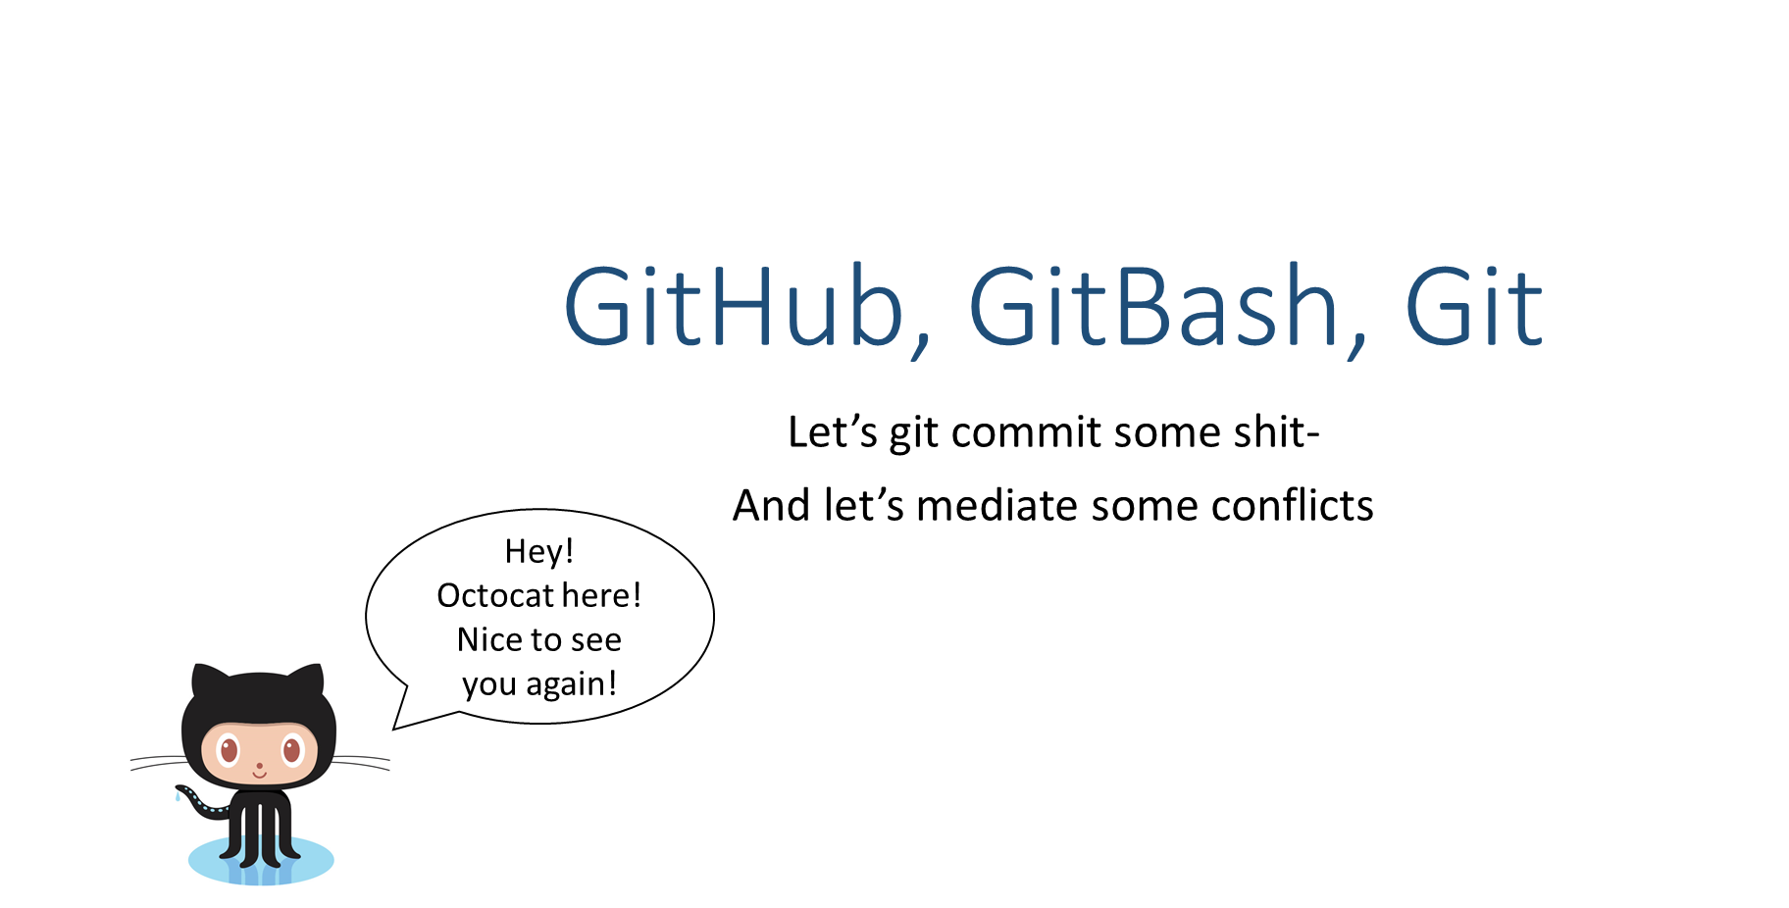

Slide 2


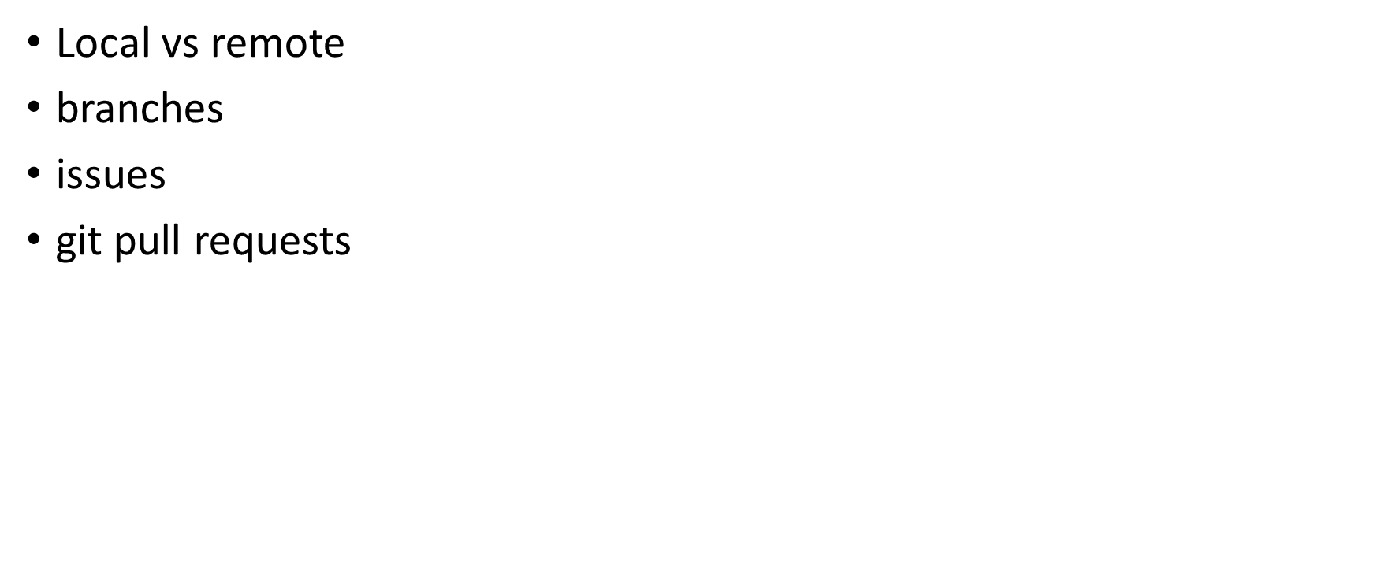
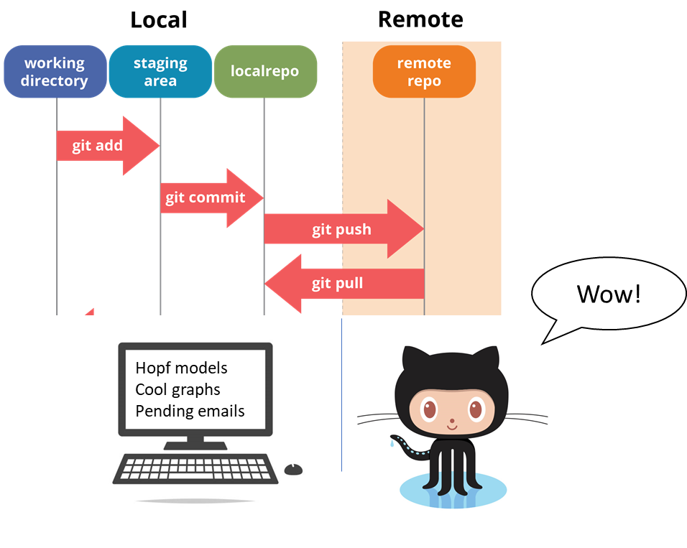


Slide 3
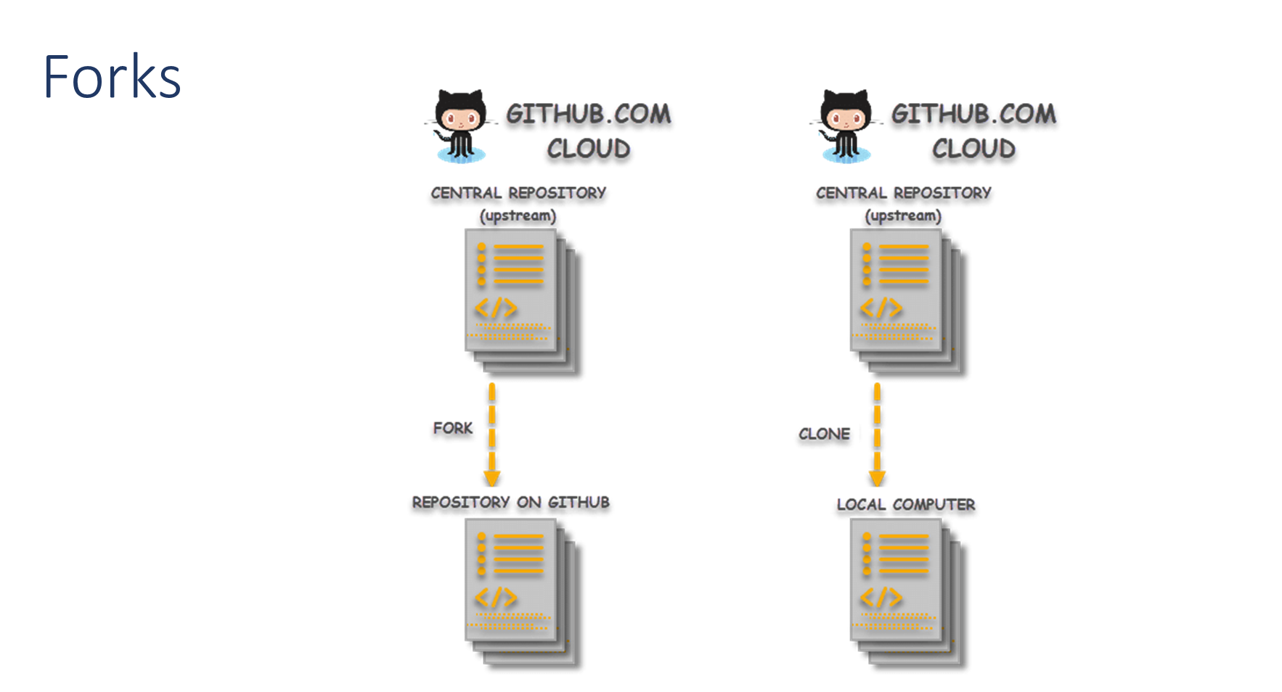

Slide 4


Slide 5


Slide 6
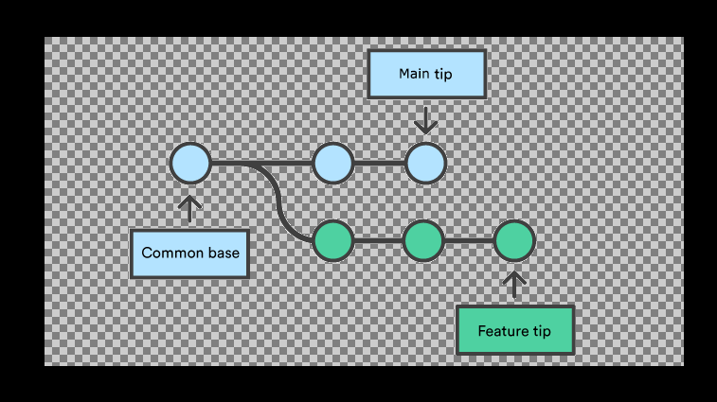

Slide 7
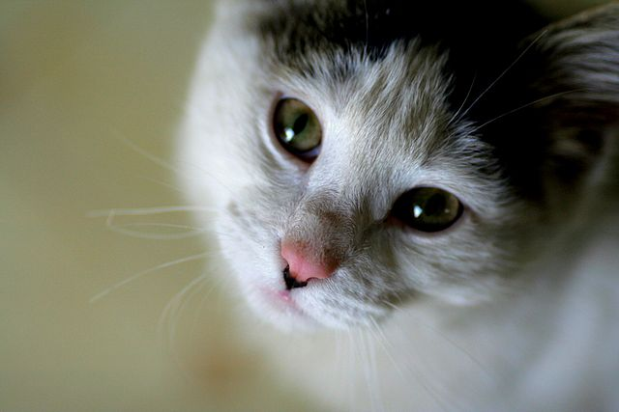
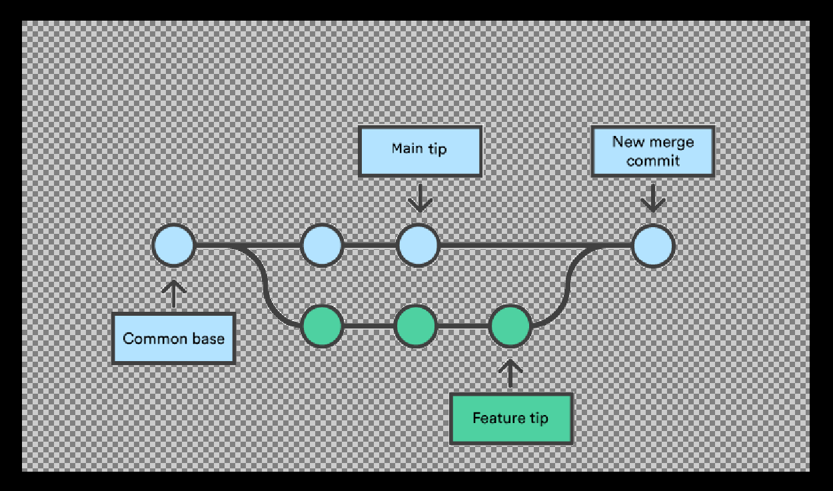

Slide 8
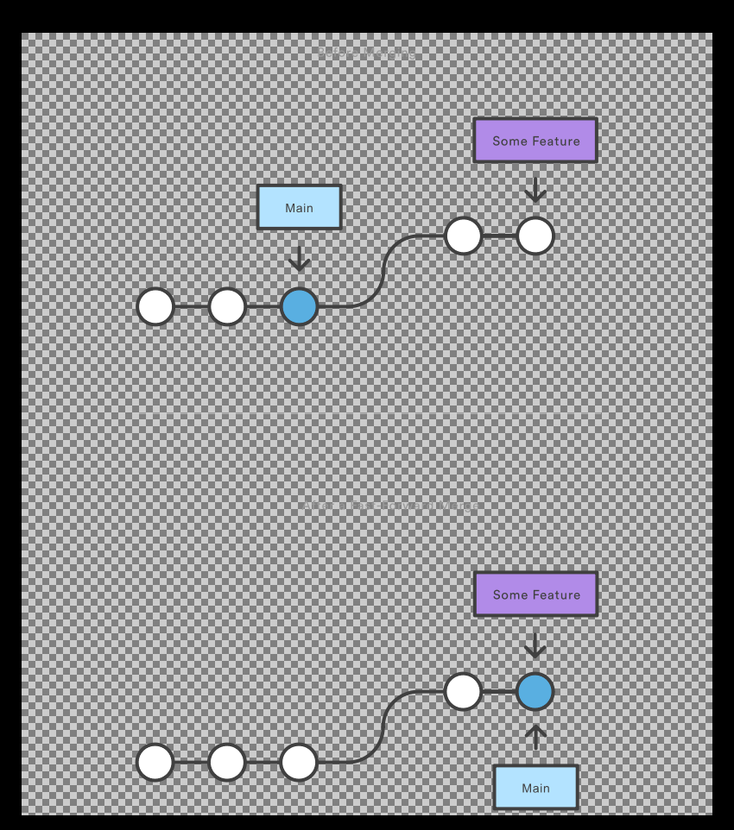


Slide 9


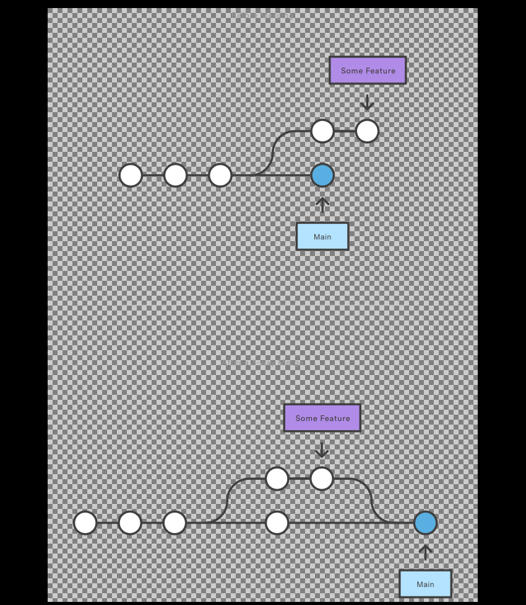



Slide 11
CONFLICTS WHEN MERGING
Fails at start
Fails during merge

Slide 12

CONFLICT STRATEGYES
PANIC! (actually don’t)
Read the message git outputs slowly and trying to anderestand
Use Alphabet’s search enginge (google)

Slide 13

Useful commands for when having conflicts (merging, not with your colleague who just put up an awfully looking presentation about Git)
git status
git log --merge
git diff
git checkout
git reset
git merge --abort

Slide 14


Slide 19
to work

